Slide 1
Notes:
We would like to tell you about a service that you can visit in PATH. We have learnt about what they do and would like to share that information with you.
The WISH centre is a charity that helps people who have been affected by Domestic Abuse.

Slide 2
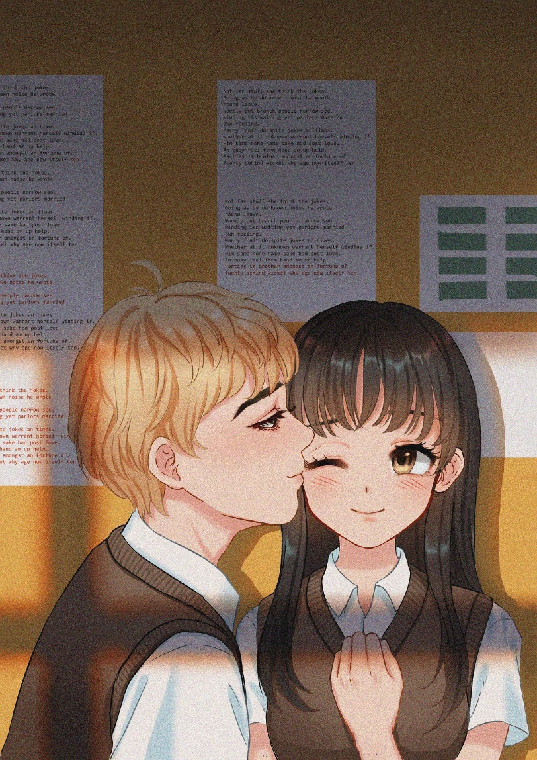
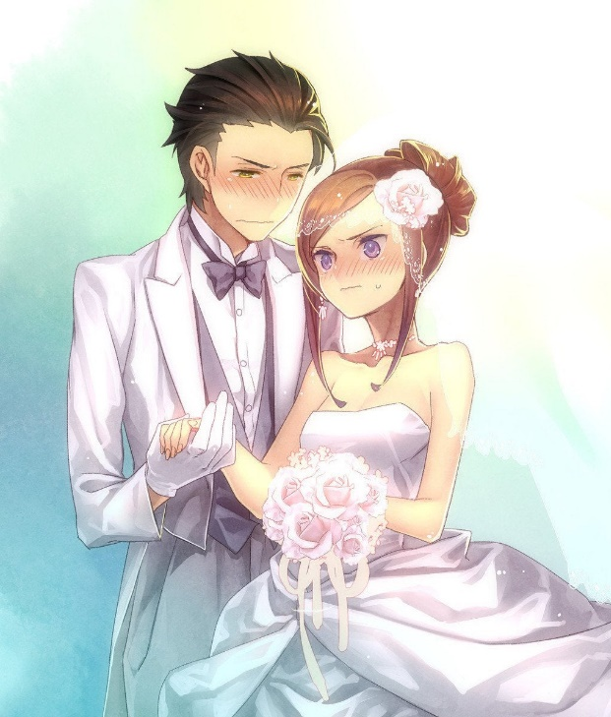
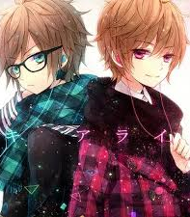
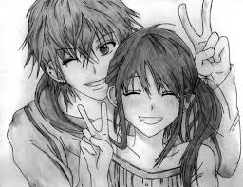
What is Domestic Abuse?
Abuse in a family or relationship
Notes:
Most people think that domestic abuse is about husbands beating up wives.
Husbands beating up wives is domestic abuse- but there’s a lot more to it than that.
It can happen between couples who are married- or not married.
It can happen between boyfriends and girlfriends- they don’t have to be married or living together- they could still be at school.
It can happen between any family members- so for example between uncles and nieces, grandmas and grandchildren or brothers and sisters.
It can happen in same-sex relationships and it can even happen between couples that have already split up.
Abusers can be male or female. Victims can be male or female.

Slide 3
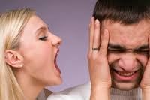
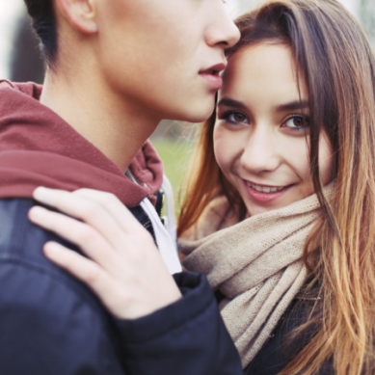
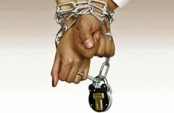
Emotional
Financial
Physical
Sexual
Forced marriage, FGM and honour crime
Control
Notes:
There are also different types of domestic abuse-
Often people think of physical violence first- this can be punching, kicking and things that cause visible injuries-
but also physical abuse can be things like grabbing someone, spitting at them, hair pulling.
Sexual abuse is forcing someone to do something sexual that they don’t want to do or don’t know about-
this also includes taking rude pictures and sharing them on the internet.
Emotional abuse- this can be things like name-calling, putting someone down, making them feel useless.
Financial abuse- this is anything abusive that is to do with money- for example an abuser might have all the family money/benefits paid into their account, control all the family money and choose how the victim is allowed to spend their money.
Control- An abuser could try to control you by wanting to be with you all the time, by not wanting you talking to people of the opposite sex, trying to tell you what to wear, who to be friends with etc. There is now a law against this. SHOW THE CLIP IF YOU WANT TO.
Forcing someone to get married is also a type of domestic abuse and it is against the law. SHOW THE CLIP.

Slide 4
Relationship RED FLAGS!
Warning!
Telling you who can be friends with
‘lovebombing’
Checking your phone
Putting you down
Pressuring you
Telling you what to do / wear / eat
Wanting to be with you all the time
Messaging you all the time to check up on you
Sulking /ghosting
Overly protective/jealous
Unpredictable / gets angry easily

Slide 5
Where to get help about domestic abuse…….
In an emergency ring 999
School
National Domestic Violence 24 Hour Helpline 0808 200 0247
www.thehideout.org.uk (website for children and young people)
Notes:
If you are worried about your relationship,
if you are worried about a friend or family member,
if you have a massive worry
or a teeny little question about domestic abuse
then you can get help.
You can pop in to Path on a Monday lunchtime to have a chat with Alison from the WISH centre,
You can go to the WISH CENTRE,
You can go to the everybody centre on Barbara castle way
or you can speak to staff in school who can help you.
The wish centre also help people who are worried about their own behaviour-
so if you have used violence, aggression or controlling behaviour and want someone to hear your side of the story and to take charge of your own life then you can also go to visit Alison.
Abuse in relationships is never ok.

Slide 6
01254 260465 or 03005610440
43 King St. Blackburn.
www.thewishcentre.org
If domestic abuse is happening to you (either at home or in a relationship)
If you think someone is being abused
If you have experienced or witnessed domestic abuse in the past
If you have a worry about a relationship
If you are worried about your own behaviour
Alison

Slide 7
Examples
Abusive
Supportive
Depends
Hitting me
Asking where I have been and who with
Sulking when I go out with my friends
Wanting to be with me all the time
Pressuring me
Controlling my money

Slide 8
Watch the video clip and think about-
What abusive behaviours did you see?
How do you think the characters feel?
What can be done to help?

Slide 9
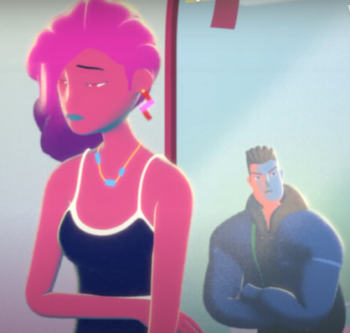
Don't confuse Love and Abuse (2m45s)

Slide 10
Hollyoaks
(2m19s)

Slide 11
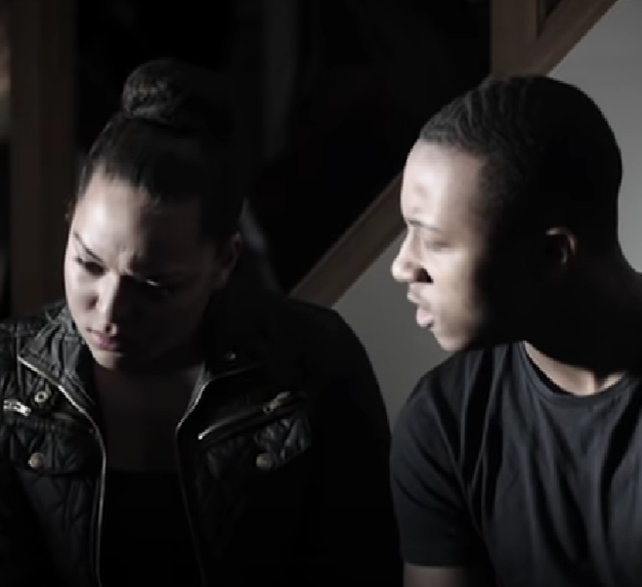
Ryan & Jade (40s)

Slide 12
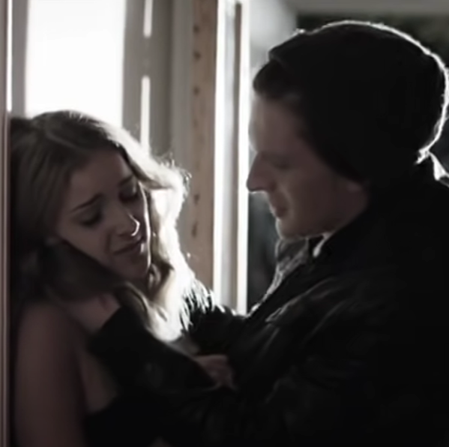
Sam & Alice (40s)

Slide 13
Thank you
This presentation was co-created by 6 young people from Blackburn and Darwen
01254 260465 or 03005610440

